Slide 1
Query by Humming Searching Oct 7th
Jiarui Xu(Jerry), Alexander Lerch

Slide 2
This week
Apply rest filter for note detection
Apply bandpass filter for note detection
Evaluate the method by calculating errors
Thinking of method to search for the most similar song in a data store

Slide 3
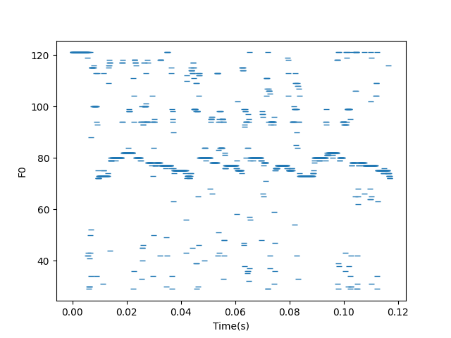
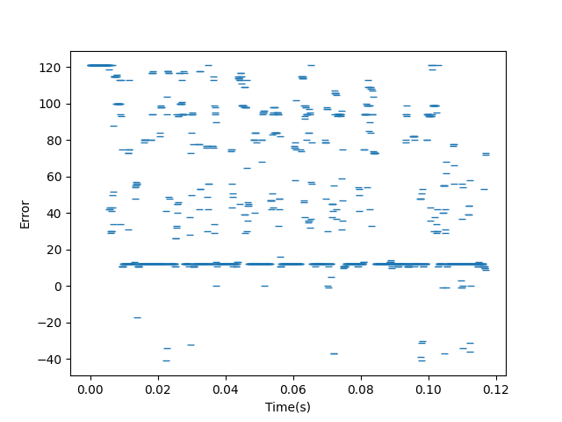
Before adding distribution(just yin algorithm)

Slide 4
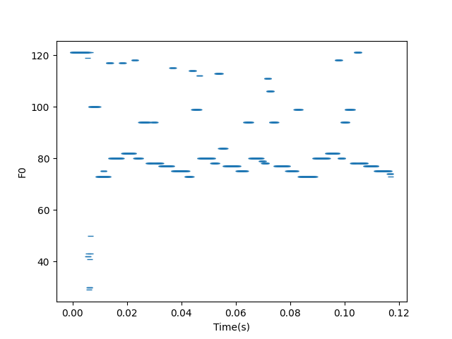
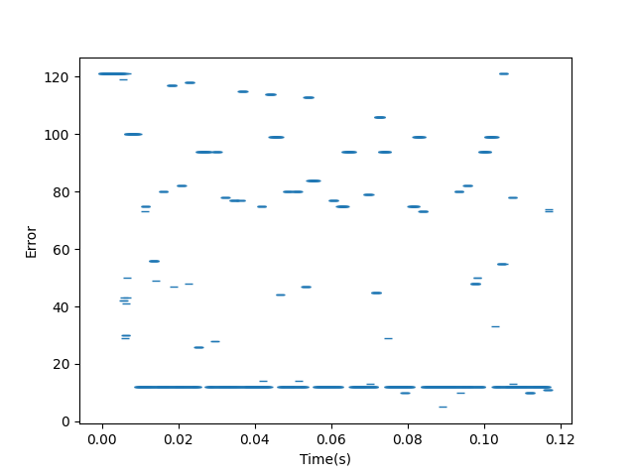
After adding statistical distribution

Slide 5
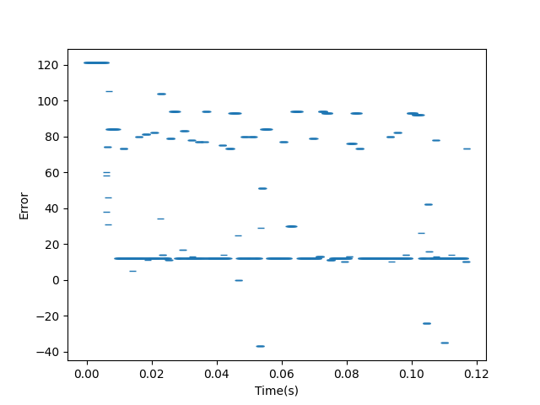
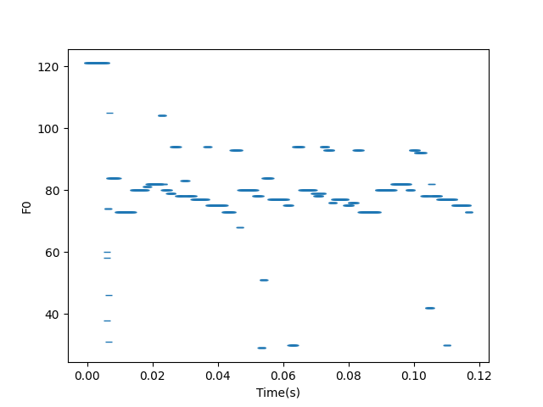
After adding bandpass filter
Use bisection to get a good threshold

Slide 6
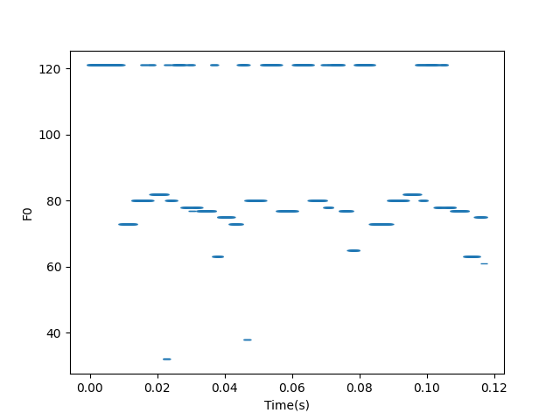
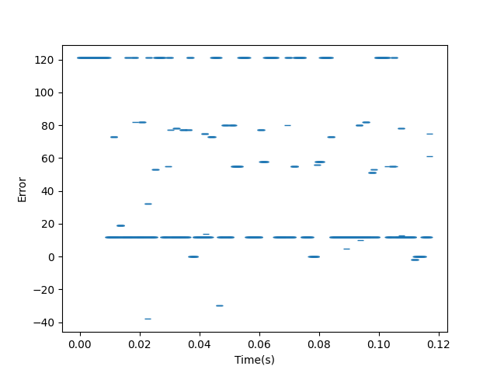
After adding rest filter(clear note achieve)
8 interval: Octave singer, the reason of error: Vocals cannot be perfectly aligned with MIDI

Slide 7
Problems in the note detection
A change in pitch occurs when the words are singing
Still some error in pitch(very small)
Vocals cannot be perfectly aligned with MIDI

Slide 8
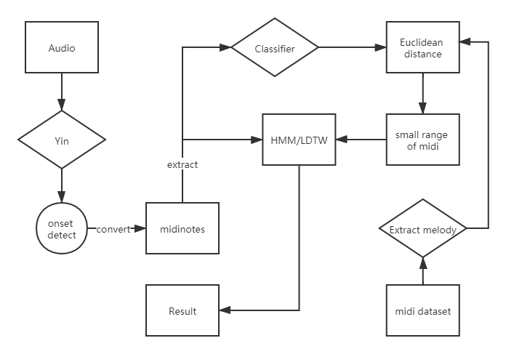

Next: Search

Slide 9
Goal
Real time(fast)
Accurate

Slide 10
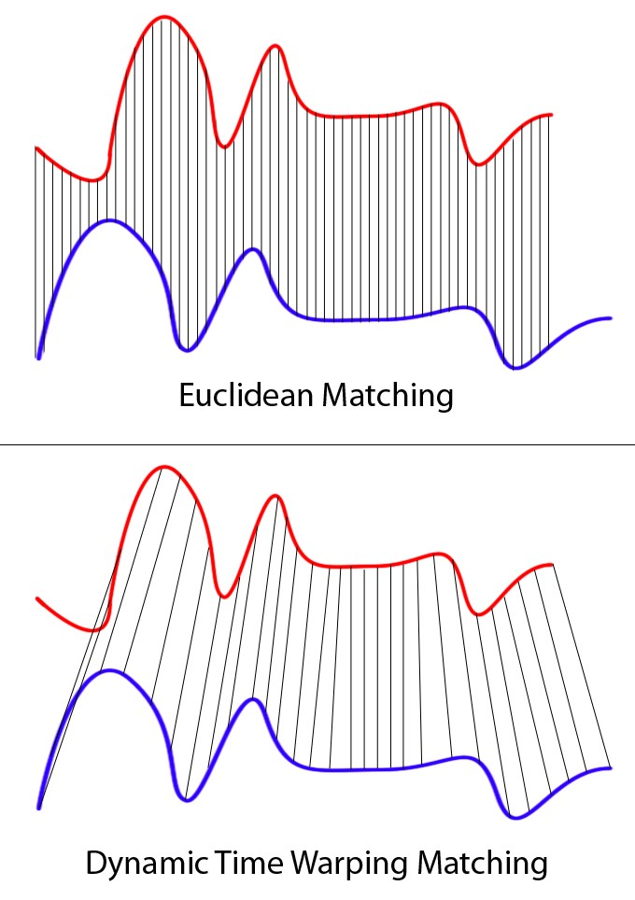
Problem in DTW
All-sided inspection but too slow

Slide 11
My idea
For data store: compress the data for each song(primary thinking)
VGGish: based on TensorFlow, VGGish. VGGish supports extracting semantic 128-dimensional embedding feature vectors from audio waveforms.
Compress pitch into one Octave
Classify the note’s duration into like: quarter note, half note etc.(but this also requires detecting tempo of vocal)
For Search: thorugh possibility model(build by machine learning) instead of using distance

Slide 12
Thank you!

